Slide 1
EduEvent
Educational Event Management System
A centralized web platform for institutions, educators & students
React
Spring Boot
MySQL
Microservices
JWT
Project Overview Presentation

Slide 2
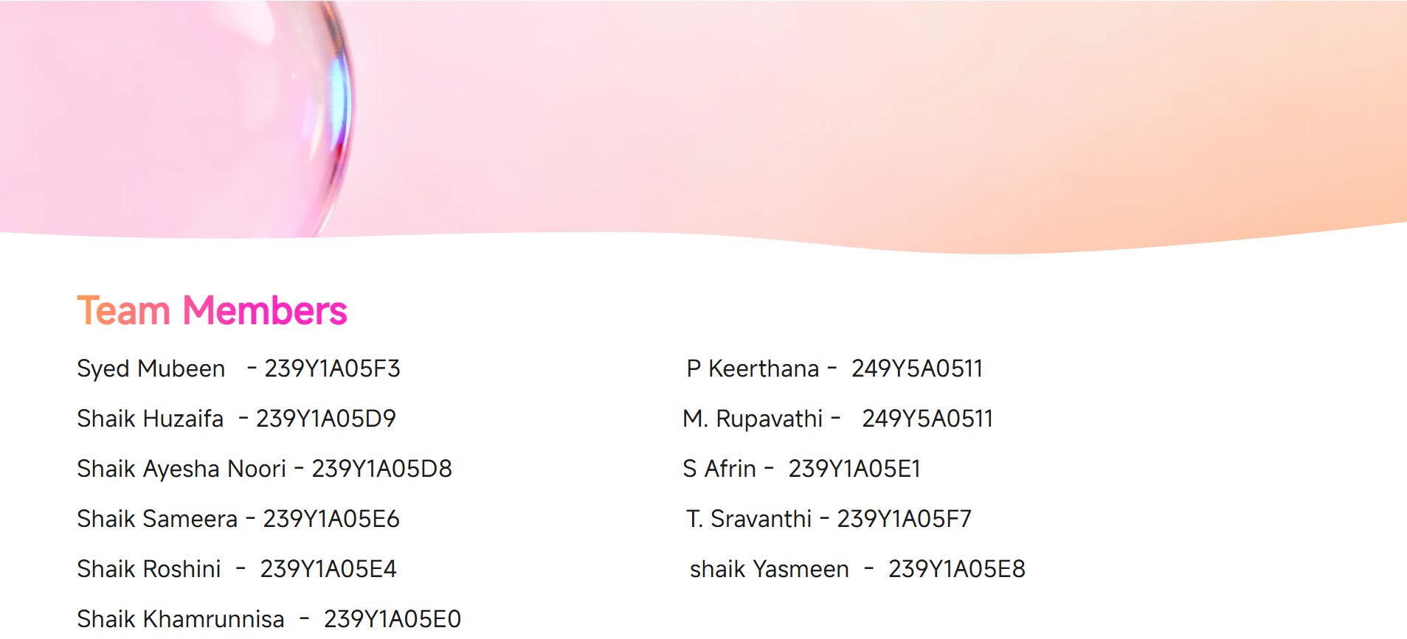
Team Members
Tech Stack
React.js
Frontend UI
Spring Boot
Backend Framework
Microservices
Architecture
MySQL
Database
JWT Auth
Security Layer

Slide 3
Problem Statement
01
02
03
Why This Matters
These issues create inefficiencies, resource waste, and poor experiences for everyone involved in educational events.
A centralized digital solution is essential to streamline coordination between institutions, educators, and students.
Manual Processes
No Central System
Resource Conflicts
Event management handled via spreadsheets, emails, and paper records.
No centralized platform for event scheduling and resource allocation.
Classrooms, projectors, and teaching aids are double-booked or under-utilized.
04
05
Student Difficulty
Educator Gap
A centralized platform solves all of these challenges.
Students struggle to find upcoming events and register for them.
Educators lack a dedicated platform to view schedules and update materials.

Slide 4
Why We Need This Platform
🏛️
Centralized Management
📦
Efficient Resources
📋
Easy Registration
Single platform for institutions to create and manage all educational events efficiently.
Organize classrooms, labs, and teaching aids without conflicts or double-booking.
Students can browse events, register online, and track their registration status.
🤝
Better Coordination
⚡
Reduced Manual Work
📊
Transparency
Improves communication between institutions, educators, and students seamlessly.
Automates previously manual event management processes, saving time and effort.
Keeps all event information structured, accessible, and easy to monitor.

Slide 5
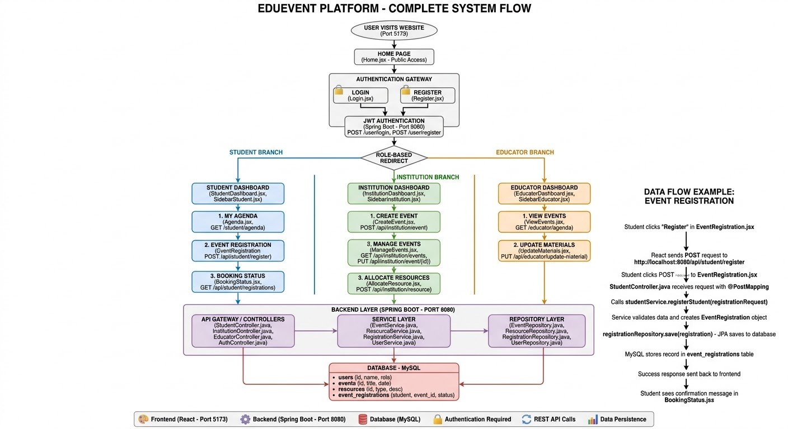

Slide 6
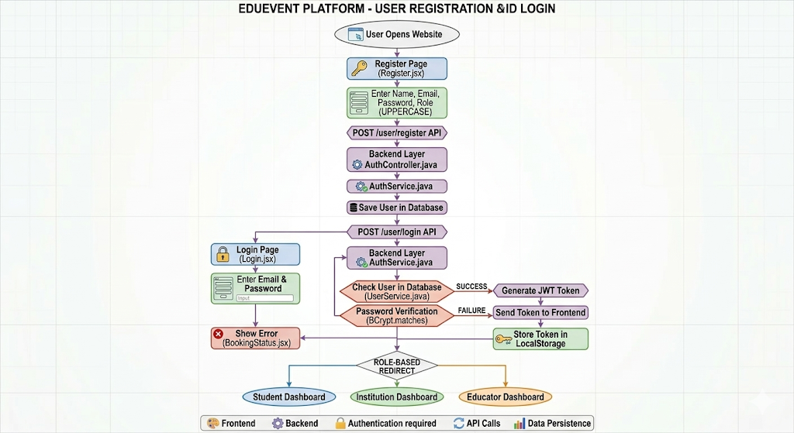
Login & Registration
Page: Login.jsx
• Endpoint: POST /user/login
• Fields: Email, Password, Role (Student/Educator/Institution)
• Response: Returns token, user id, name, email, role
• On success: Redirect to role-based dashboard
Page: Register.jsx
• Endpoint: POST /user/register
• Fields: Name, Email, Role, Password, Confirm Password
• Request: Sends name, email, password, role
• On success: Redirect to Login page
Login Page
Register Page

Slide 7
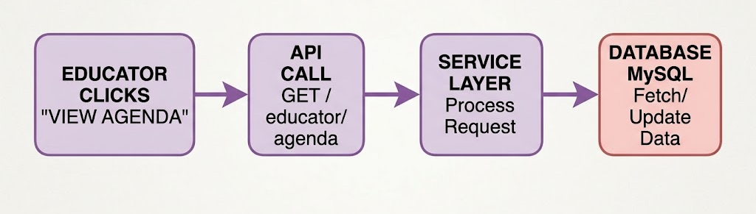
Educator Service
Retrieve Event Agenda
View events assigned to educator
Upload/Update Materials
Add learning resources to
Controller Layer
Service Layer
Model Layer

Slide 8
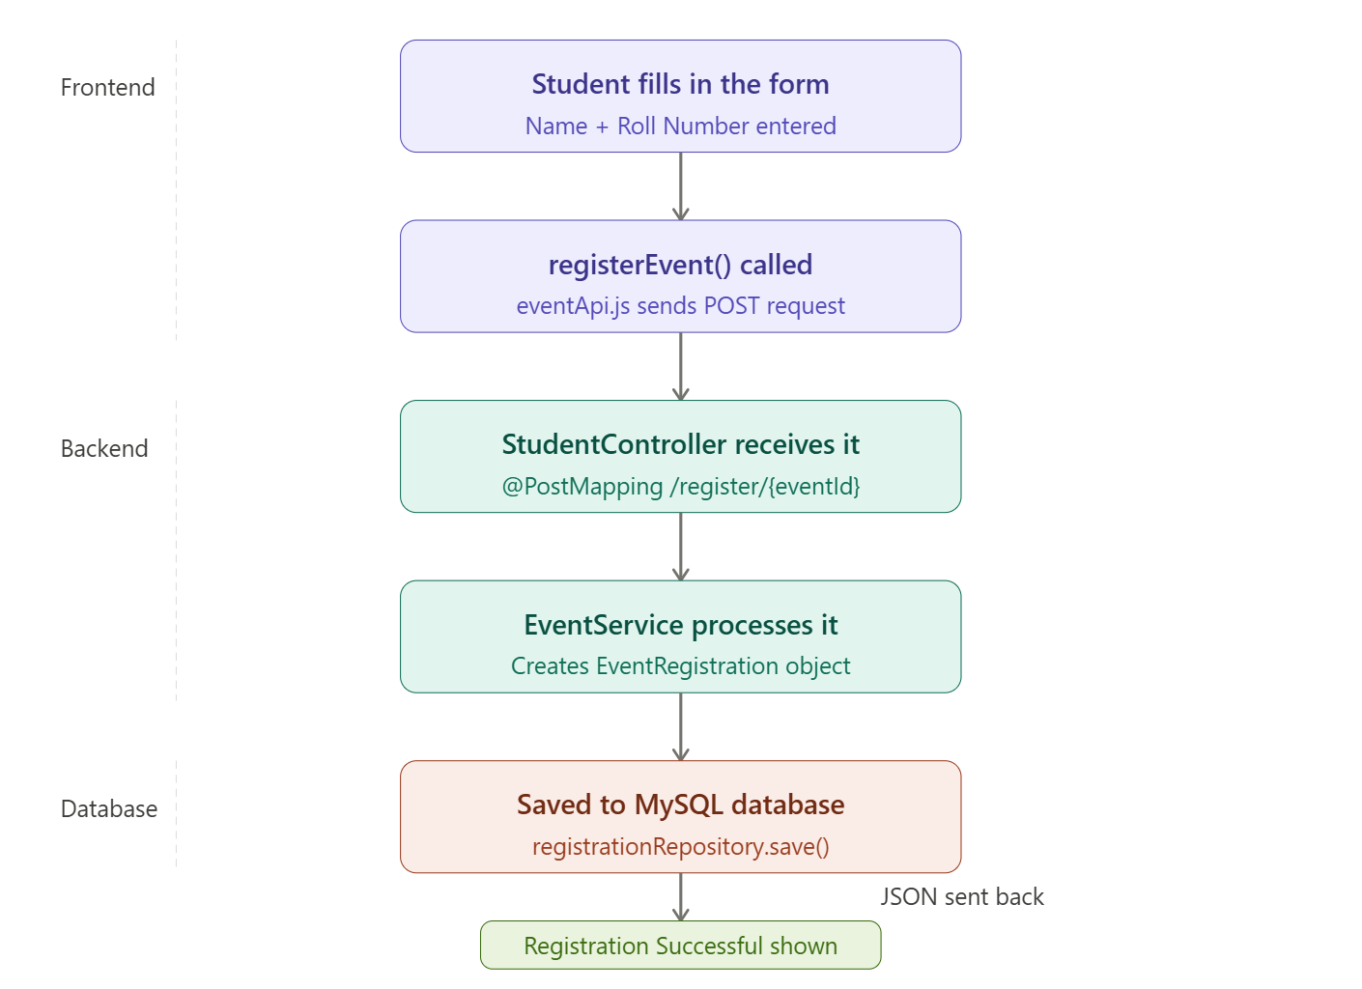
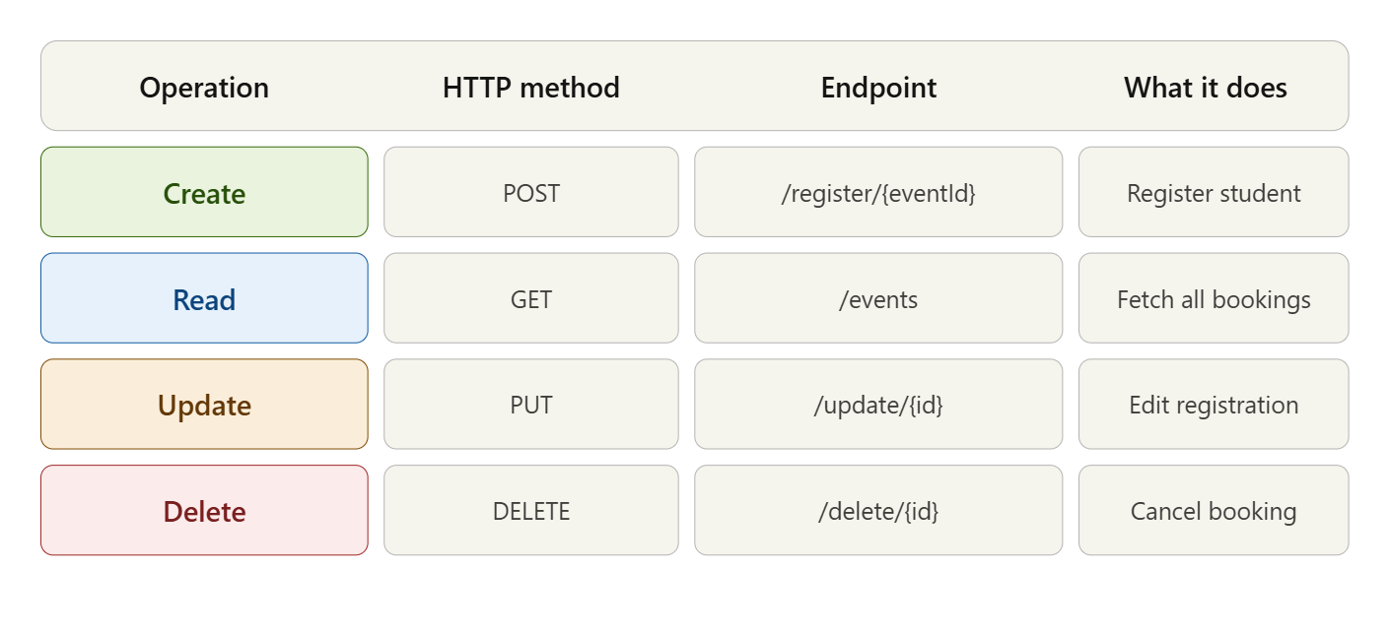
Student Registration Service
Event Registration
Students can register for available events
Booking Status
View all registrations in a table
Registration Tracking
Check confirmation and waitlist status

Slide 9
Institution Dashboard — Overview
Three interconnected React components managing events & resources
CreateEvent.js
AllocateResource.js
InstitutionDashboard.js
Purpose:
Form to create events & save to localStorage
Key Features:
• useState for title & message
• Saves to localStorage
• Navigate to manage-events
• Shows last 3 recent events
Storage:
localStorage (client-side)
Purpose:
Allocate resources via REST API
Key Features:
• POST to /api/institution/resource
• Fetches recent on mount (useEffect)
• Loading & error states
• Redirects on success
Storage:
Backend API (localhost:8080)
Purpose:
Main hub: stats, events & resources
Key Features:
• GET /api/institution/dashboard
• Polls every 10 seconds
• Stats grid (events + resources)
• Quick-action nav buttons
Auth:
User loaded from localStorage
All components share SidebarInstitution • React Router (useNavigate) • Shared institution.css styles

Slide 10
Workflow Flowchart — Institution Dashboard
CreateEvent.js
AllocateResource.js
InstitutionDashboard.js
User opens CreateEvent page
Page loads
useEffect fires
Dashboard mounts
useEffect fires
Enter Event Title
(controlled input)
GET /resources/recent
from backend
Load user from
localStorage
Submit form
onSubmit handler
User enters resource type
& submits
GET /dashboard
fetch stats + lists
Title empty?
Backend OK?
Render stats grid
Recent events/resources
No ↓
Yes ↓
Save to localStorage
+ show success msg
POST /resource
JSON body sent
Poll every 10s
setInterval refresh
Navigate to
manage-events (2s)
Show success
Navigate to dashboard
updates
User clicks
Create Event / Allocate
Input/Trigger
Action/Save
Decision/Check
Cross-component trigger

Slide 11
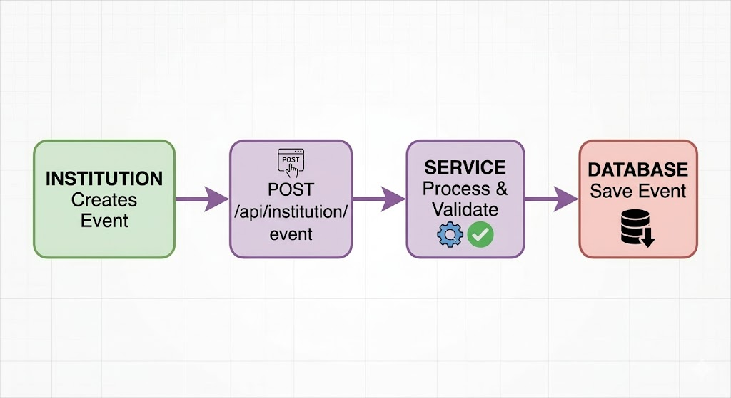
Event Creation & Scheduling
Educator Service
Student Registration Service
Institution Dashboard Service
01
02
03
Allows educators to view their event agenda and update event materials.
Manages student event registrations and registration status tracking.
Provides centralized dashboard for institutions to manage events and resources.

Slide 12
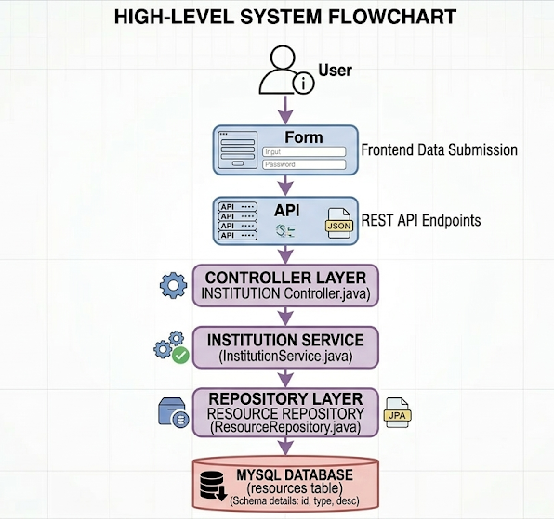
Resource Allocation Service
Prevent double-booking
View resources by event
Allocate resources to specific events
Add new resources to inventory

Slide 13
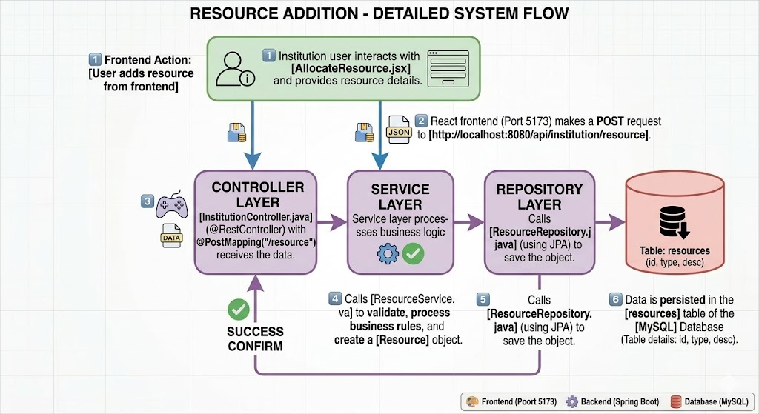
Event & Resource Management Service

Slide 14
Thank You
EduEvent — Educational Event Management System
Centralizing institutions, educators, and students on one powerful platform.
React.js Frontend
Spring Boot Microservices
MySQL Database
JWT Security
Built for educational institutions to streamline event operations

